Slide 1

The Invisible One
Notes:
jack

Slide 2
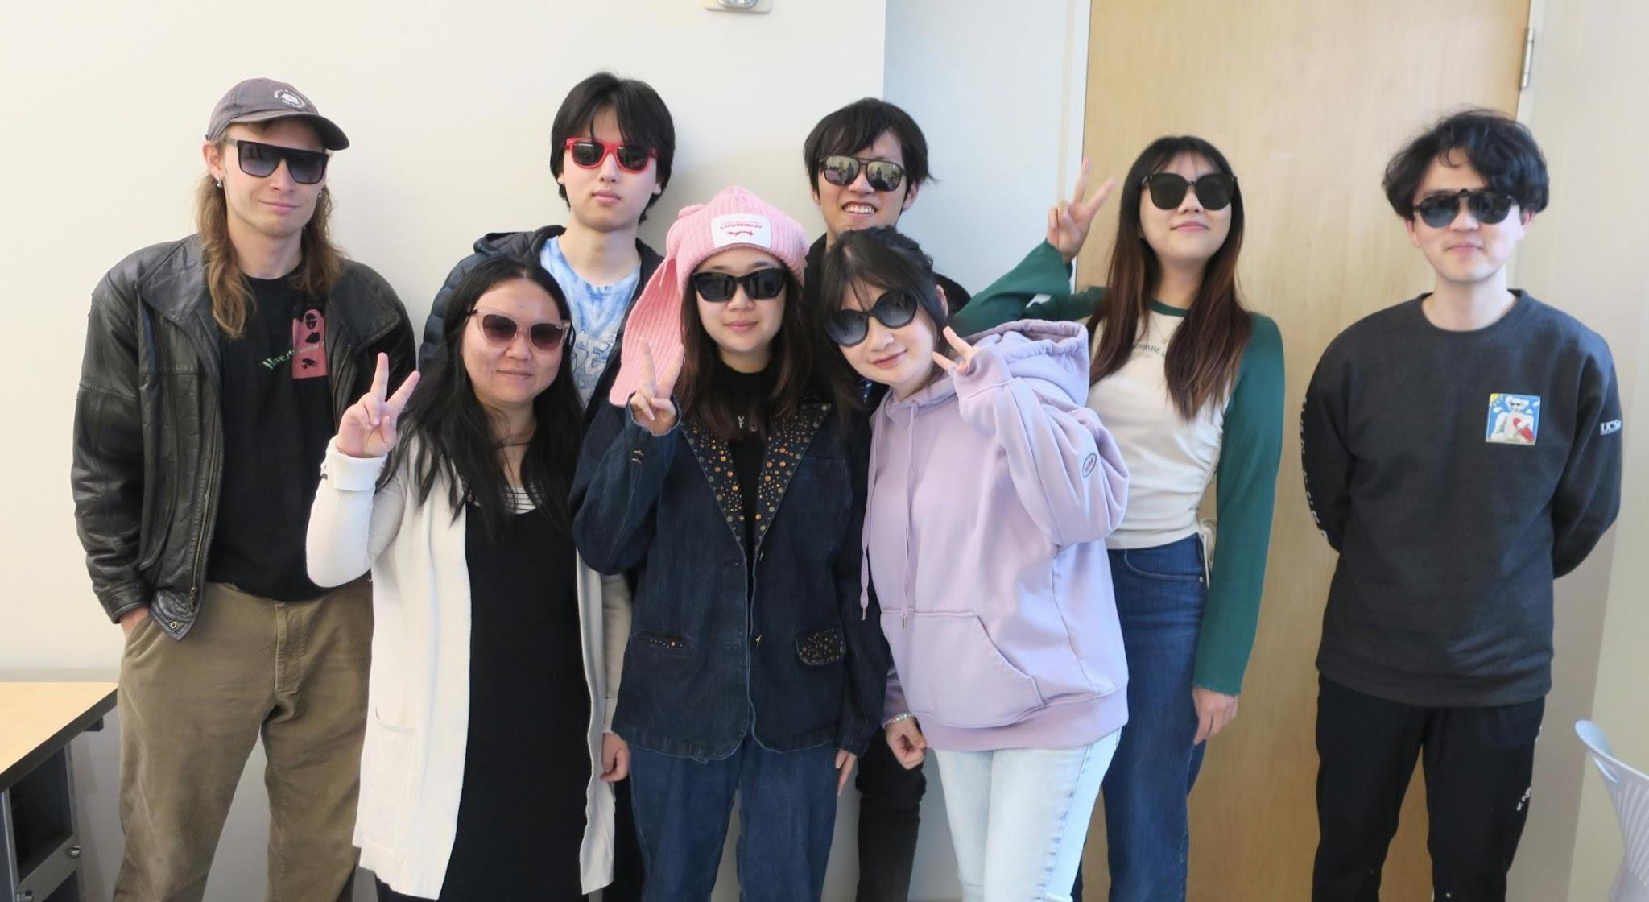
Blinder
Yingkai Lee
The Seahorse
Yucheng Huang
Animation Ninja
Jack Wagner
Master of Soundtrack Shenanigans
Manshi Yang
Synchronization Maestro
Zhiying Guan
Polygon Picasso
Jiahui Han
Master of Pixel Perfection
Ashley Kou
CEO
Xiaoxiao Zou
Chief Coffee Consumer
Notes:
Ashley

Slide 3
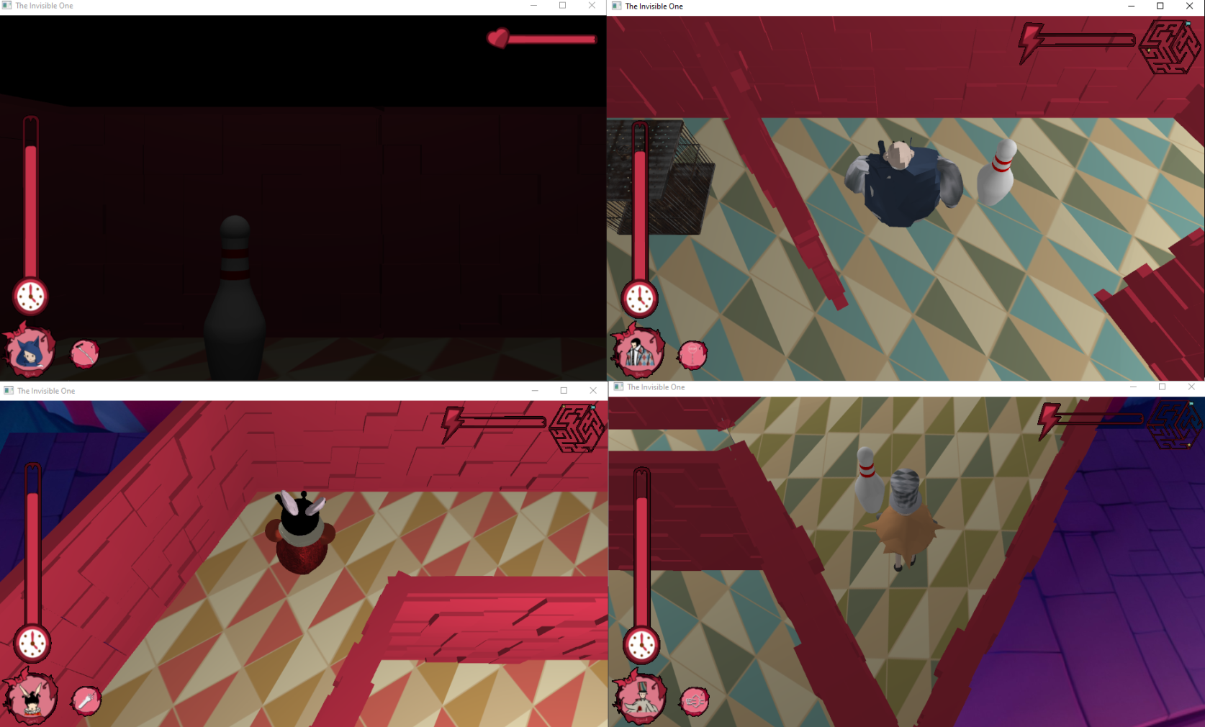
The Experiment
Notes:
Our game is a unique RPG in which players will have two different perspectives: one is a dark first-person view, and the others are normal third-person view. And the goal of the game is (next page) jack

Slide 4
Help the visually-impaired player get out of the maze!
Notes:
So, this is a collaborative game, and during the gameplay, feel free to talk with each other! jack

